Slide 1
Molecular Detective Work
How the dances of proteins reveal complex personalities
Yousuf O. Ramahi

Slide 2
Please ask a lot of questions.
Thank you.

Slide 3
Proteins are life’s molecular machines.
Illustration of the Cytoplasm, David Goodsell

Slide 4
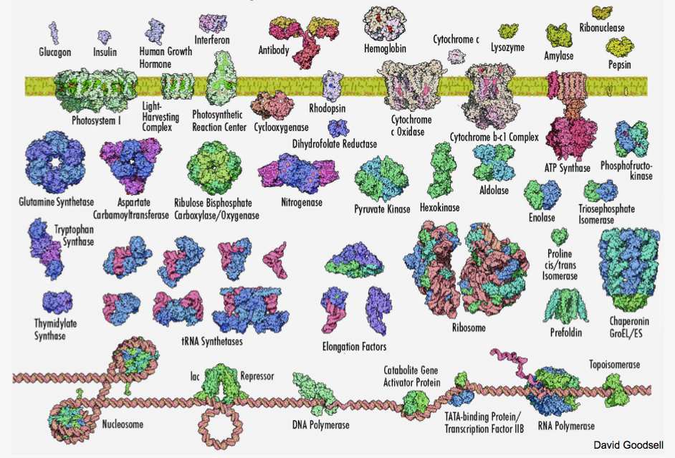
Proteins are a diverse set of molecules, structurally and functionally

Slide 5
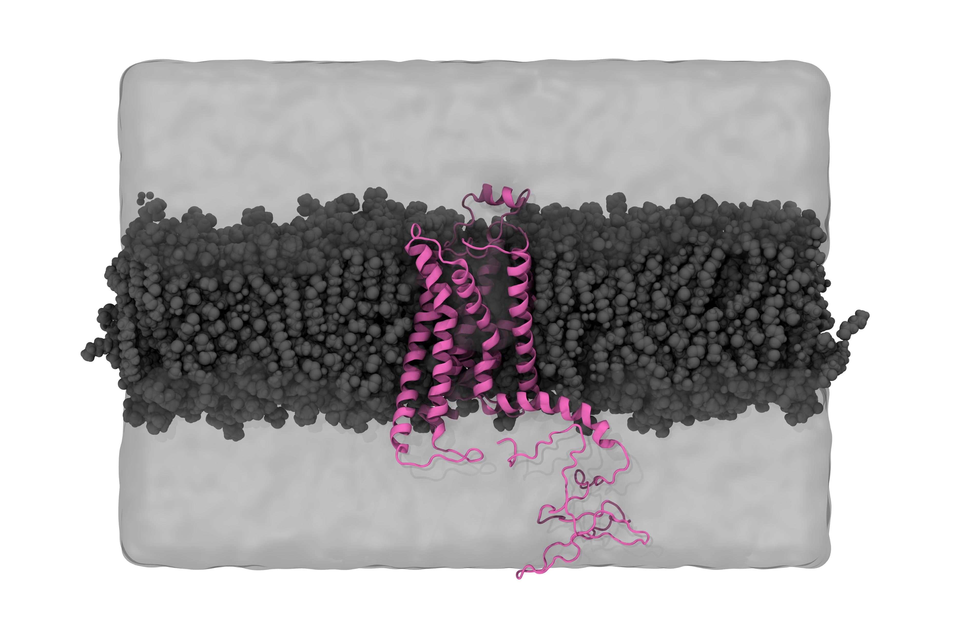
The adenosine A_{2A} receptor is the protein I’m studying!

Slide 6
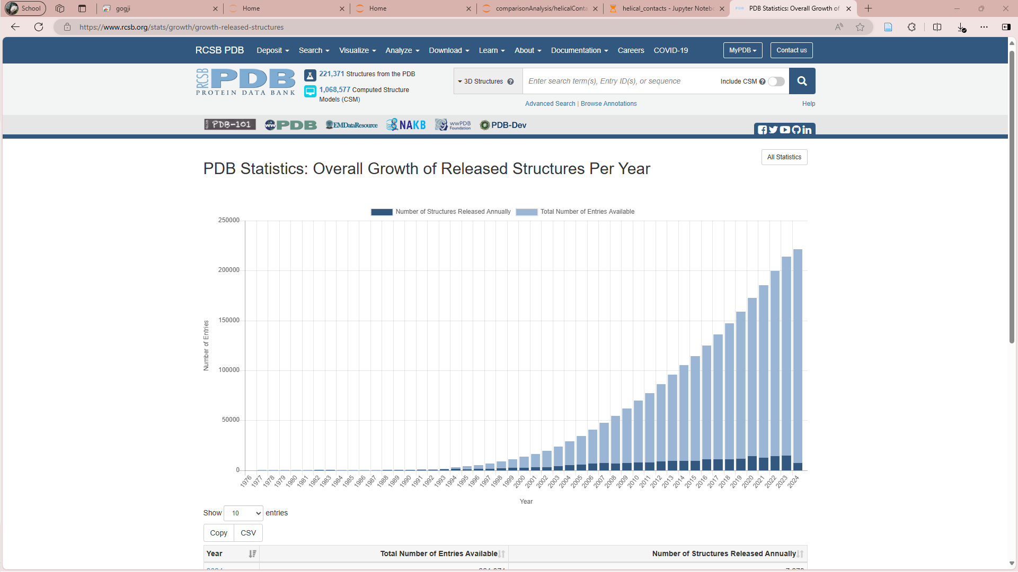
> 221’000 protein structures in the Protein Data Bank (PDB)

Slide 7
How do proteins fold into such complex and stable structures?

Slide 8
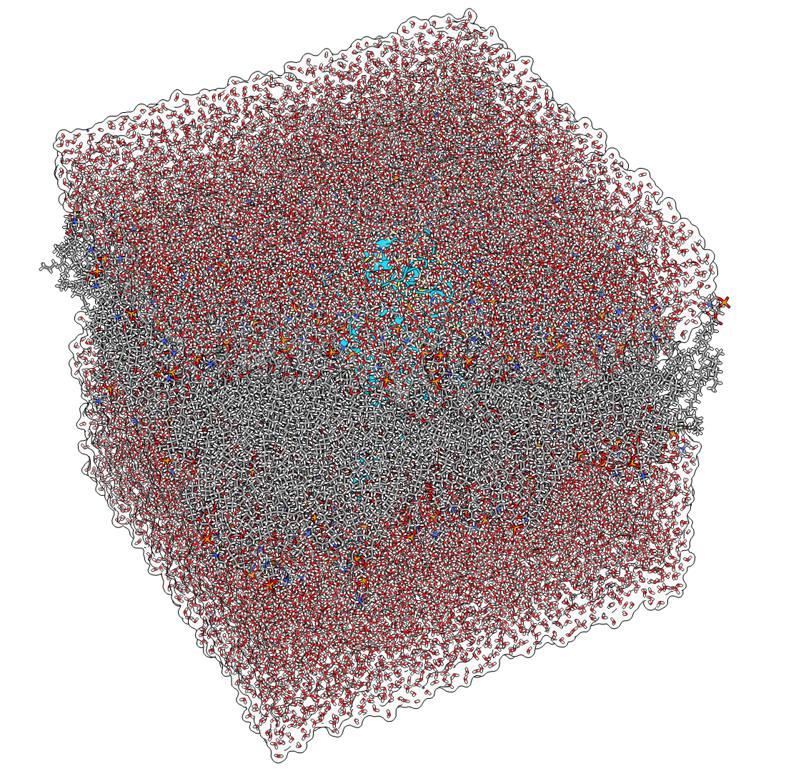
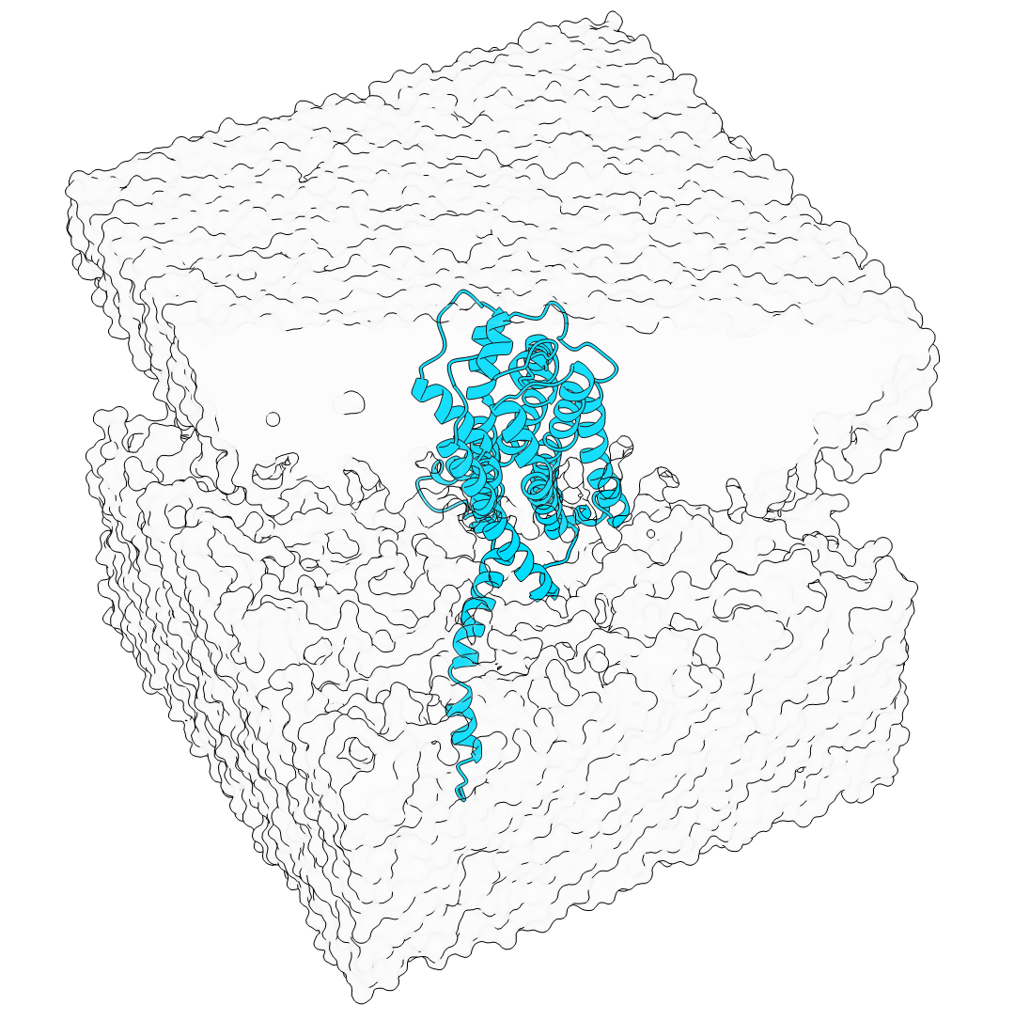
We can study this using an ‘all-atom’ simulation approach
A_{2A} embedded in a lipid bilayer and solvated.

Slide 9
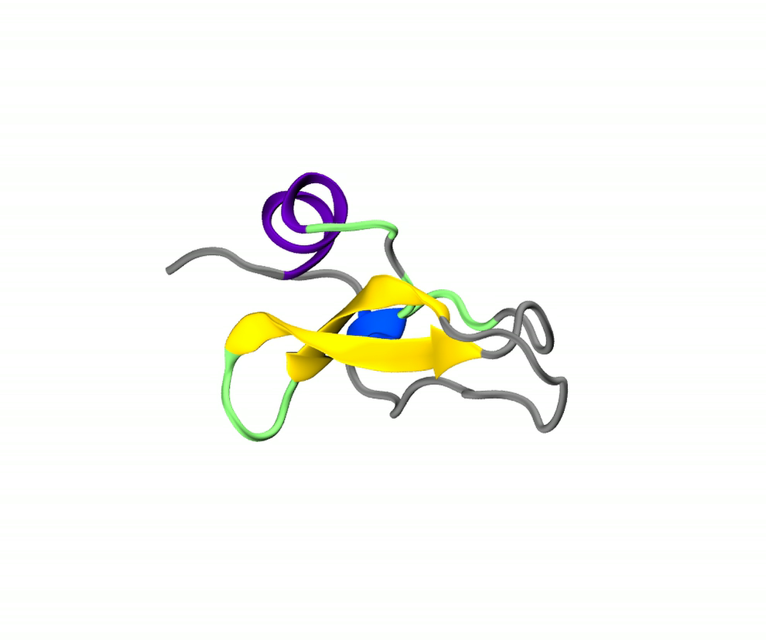
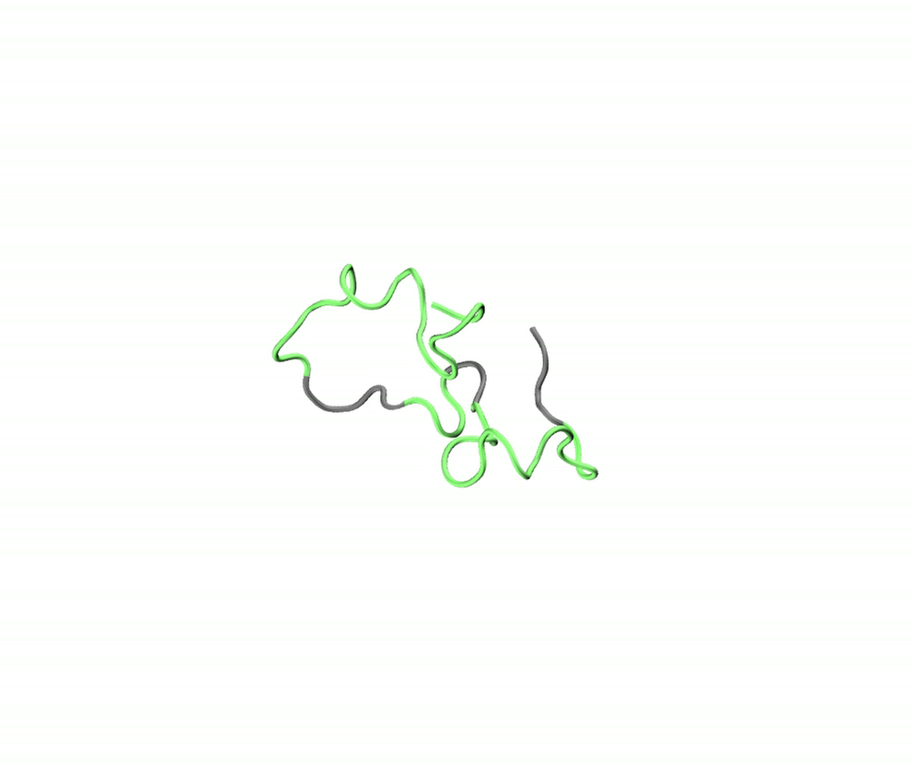
Folded protein dynamics
Disordered protein dynamics

Slide 10
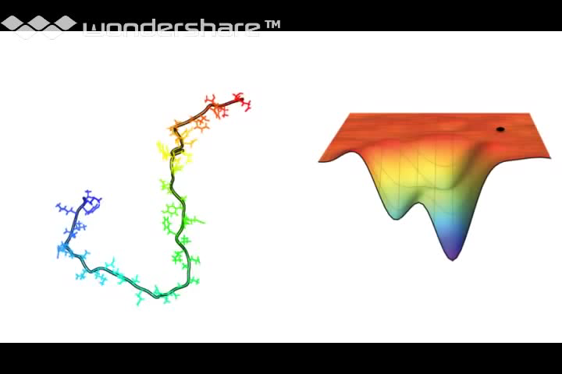
Protein folding is described by an ‘energy landscape’

Slide 11
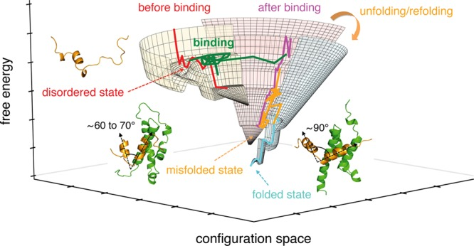
Chong SH et al., ACS Cent Sci. 2019 Aug 28;5(8):1342-1351.

Slide 12
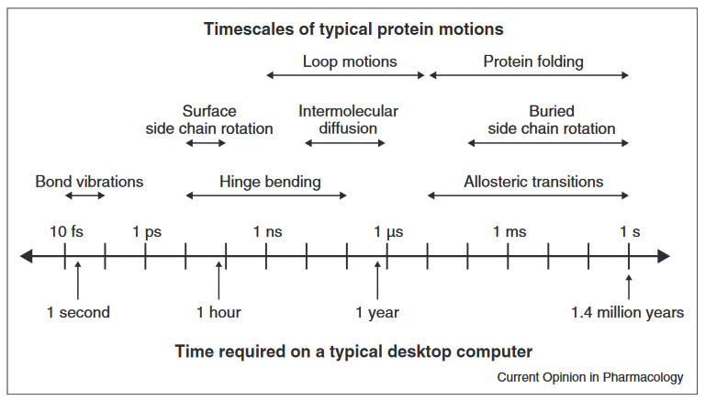
Simulations are expensive – we require the use of ‘supercomputers’
Zwier and Chong, Current Opinion in Pharmacology 2010, 10:745–752
Notes:
There is a balance between:
Money
Complexity of the system (size)
Capability of the computer(s)

Slide 13
Our ‘computational microscope’ enables access to time- and length-scales beyond any experimental methods
With all the information at our fingertips, we become detectives that interrogate the dynamics of proteins and interpret meaning from their complex dances.

